Slide 1

Database Systems:
Design, Implementation, and Management
Tenth Edition
Chapter 5
Advanced Data Modeling

Slide 2
Objectives
In this chapter, students will learn:
  About the extended entity relationship (EER) model
  How entity clusters are used to represent multiple entities and relationships
  The characteristics of good primary keys and how to select them
  How to use flexible solutions for special data modeling cases
Database Systems, 10th Edition

Slide 3
The Extended Entity
Relationship Model
Result of adding more semantic constructs to original entity relationship (ER) model
Diagram using this model is called an EER diagram (EERD)
Database Systems, 10th Edition

Slide 4
Entity Supertypes and Subtypes
Entity supertype
  Generic entity type related to one or more entity subtypes
  Contains common characteristics
Entity subtype
  Contains unique characteristics of each entity subtype
Database Systems, 10th Edition

Slide 5
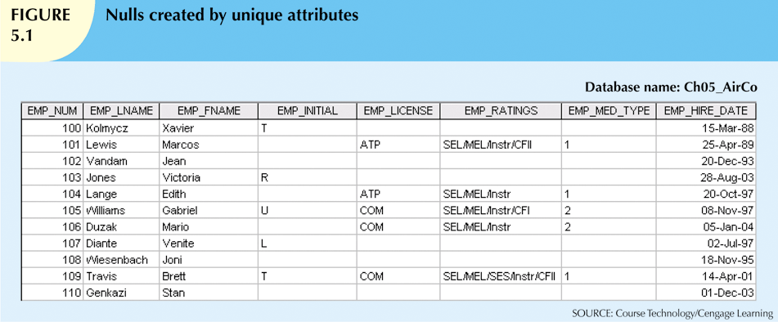
Database Systems, 10th Edition

Slide 6
Specialization Hierarchy
Depicts arrangement of higher-level entity supertypes and lower-level entity subtypes
Relationships described in terms of “IS-A” relationships
Subtype exists only within context of supertype
Every subtype has only one supertype to which it is directly related
Can have many levels of supertype/subtype relationships
Database Systems, 10th Edition

Slide 7
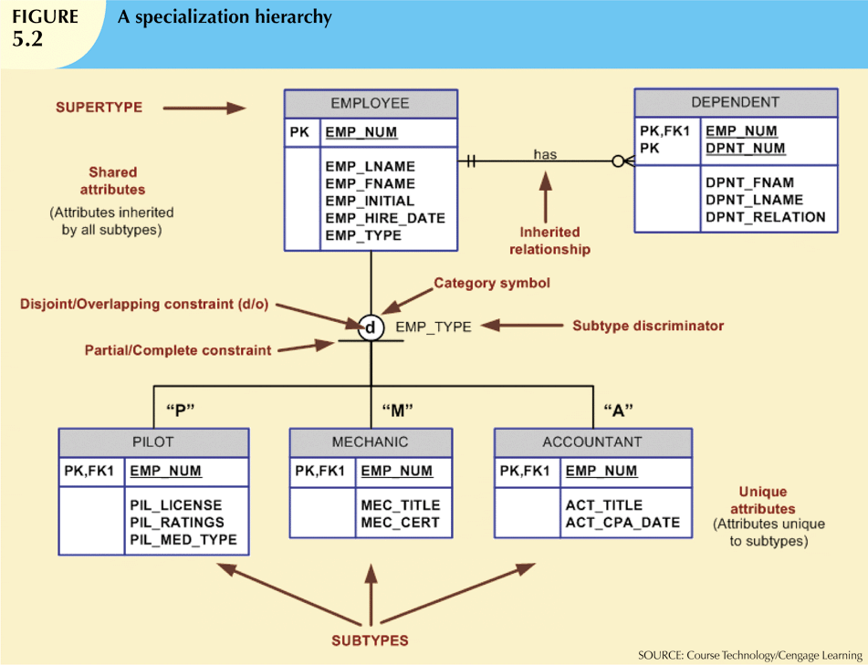
Database Systems, 10th Edition

Slide 8
Inheritance
Enables entity subtype to inherit attributes and relationships of supertype
All entity subtypes inherit their primary key attribute from their supertype
At implementation level, supertype and its subtype(s) maintain a 1:1 relationship
Entity subtypes inherit all relationships in which supertype entity participates
Lower-level subtypes inherit all attributes and relationships from all upper-level supertypes
Database Systems, 10th Edition

Slide 9
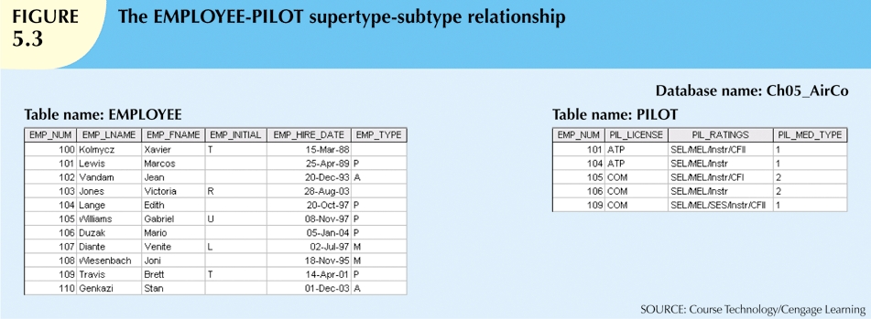
Database Systems, 10th Edition

Slide 10
Subtype Discriminator
Attribute in supertype entity
  Determines to which entity subtype each supertype occurrence is related
Default comparison condition for subtype discriminator attribute is equality comparison
Subtype discriminator may be based on other comparison condition
Database Systems, 10th Edition

Slide 11
Disjoint and Overlapping Constraints
Disjoint subtypes
  Also called nonoverlapping subtypes
  Subtypes that contain unique subset of supertype entity set
Overlapping subtypes
  Subtypes that contain nonunique subsets of supertype entity set
Database Systems, 10th Edition

Slide 12
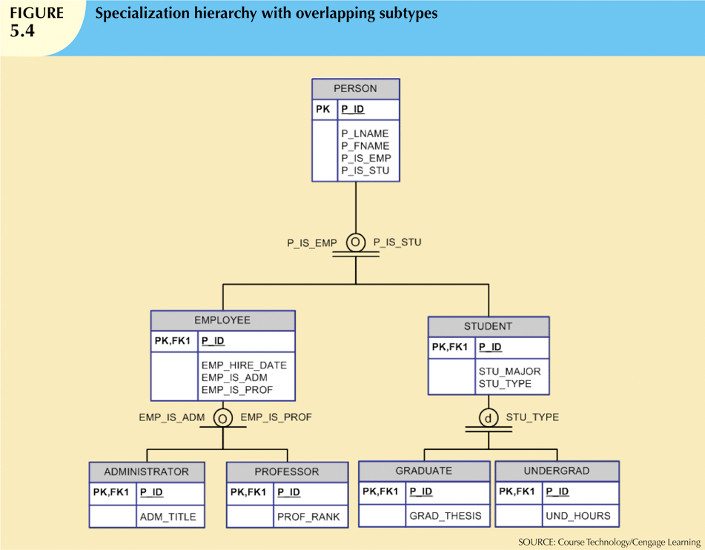
Database Systems, 10th Edition

Slide 13
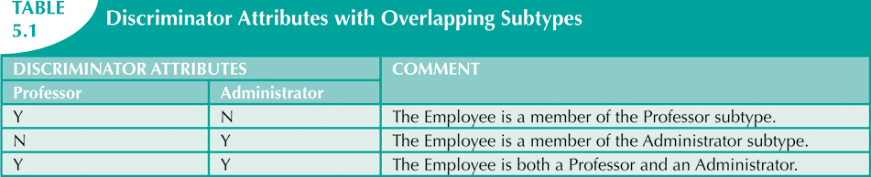
Database Systems, 10th Edition

Slide 14
Completeness Constraint
Specifies whether entity supertype occurrence must be a member of at least one subtype
Partial completeness
  Symbolized by a circle over a single line
  Some supertype occurrences are not members of any subtype
Total completeness
  Symbolized by a circle over a double line
  Every supertype occurrence must be member of at least one subtype
Database Systems, 10th Edition

Slide 15
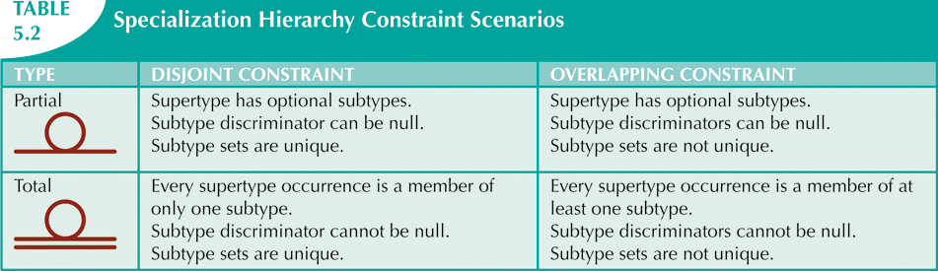
Database Systems, 10th Edition

Slide 16
VISIO 2010
To add “d” or “o” symbol
  Click on “A Text”
  Type the d or o
  Click back to “pointer tool”
  Drag text to connector
To change Partial to Total (sgl to dbl line)
  Right click connector
  Select Database Properties
  Click on “Category is complete”
Database Systems, 10th Edition

Slide 17
Specialization and Generalization
Specialization
  Identifies more specific entity subtypes from higher-level entity supertype
  Top-down process
  Based on grouping unique characteristics and relationships of the subtypes
Database Systems, 10th Edition

Slide 18
Specialization and Generalization
(cont’d.)
Generalization
  Identifies more generic entity supertype from lower-level entity subtypes
  Bottom-up process
  Based on grouping common characteristics and relationships of the subtypes
Database Systems, 10th Edition

Slide 19
Entity Clustering
“Virtual” entity type used to represent multiple entities and relationships in ERD
Considered “virtual” or “abstract” because it is not actually an entity in final ERD
Temporary entity used to represent multiple entities and relationships
Eliminate undesirable consequences
  Avoid display of attributes when entity clusters are used
Database Systems, 10th Edition

Slide 20
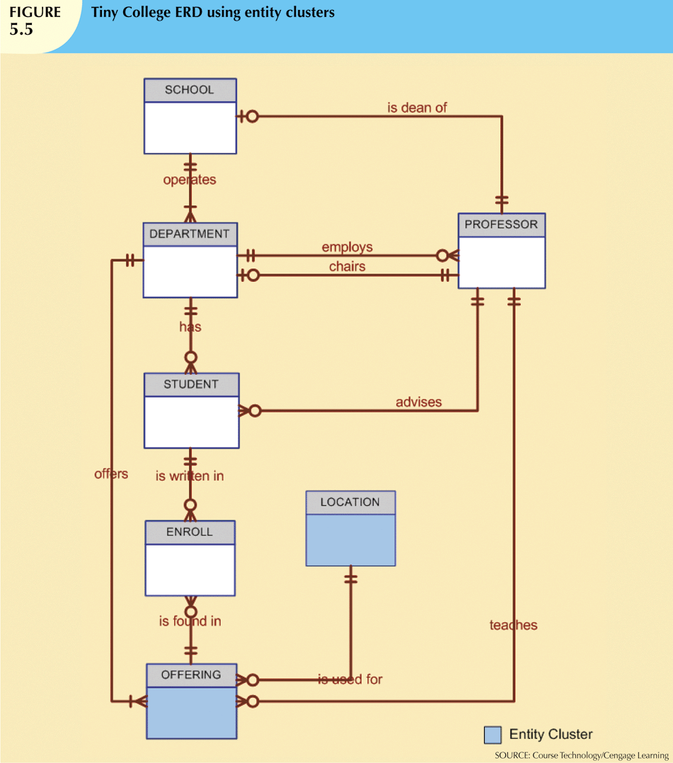
Database Systems, 10th Edition

Slide 21
Entity Integrity:
Selecting Primary Keys
Primary key is the most important characteristic of an entity
  Single attribute or some combination of attributes
Primary key’s function is to guarantee entity integrity
Primary keys and foreign keys work together to implement relationships
Properly selecting primary key has direct bearing on efficiency and effectiveness
Database Systems, 10th Edition

Slide 22
Natural Keys and Primary Keys
Natural key is a real-world identifier used to uniquely identify real-world objects
  Familiar to end users and forms part of their day-to-day business vocabulary
Generally, data modeler uses natural identifier as primary key of entity being modeled
May instead use composite primary key or surrogate key
Database Systems, 10th Edition

Slide 23
Primary Key Guidelines
Attribute that uniquely identifies entity instances in an entity set
  Could also be combination of attributes
Main function is to uniquely identify an entity instance or row within a table
Guarantee entity integrity, not to “describe” the entity
Primary keys and foreign keys implement relationships among entities
  Behind the scenes, hidden from user
Database Systems, 10th Edition

Slide 24
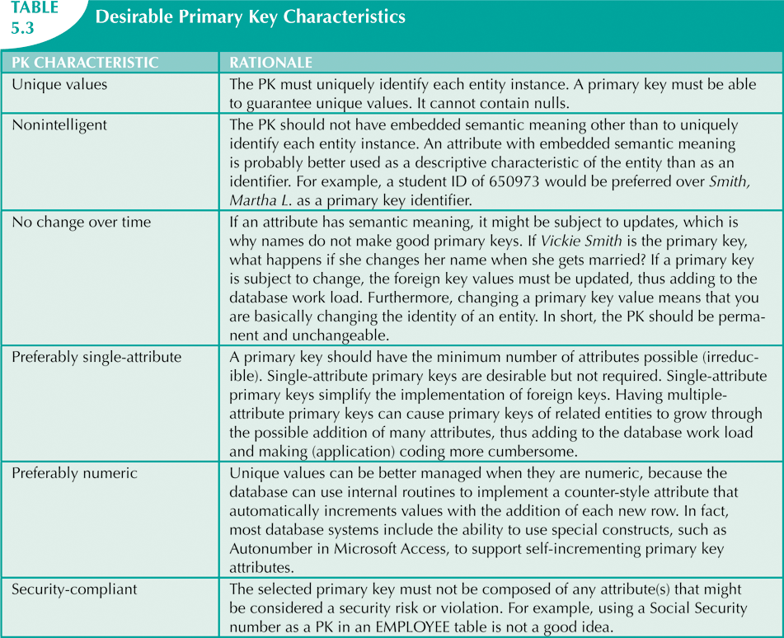
Database Systems, 10th Edition

Slide 25
When to Use Composite Primary Keys
Composite primary keys useful in two cases:
  As identifiers of composite entities
    In which each primary key combination is allowed once in M:N relationship
  As identifiers of weak entities
    In which weak entity has a strong identifying relationship with the parent entity
Automatically provides benefit of ensuring that there cannot be duplicate values
Database Systems, 10th Edition

Slide 26
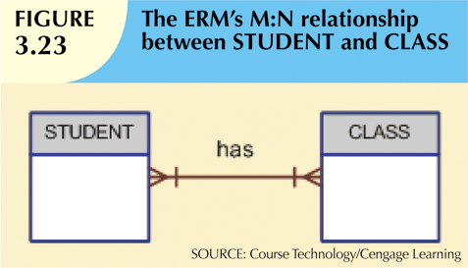
Database Systems, 10th Edition

Slide 27

Database Systems, 10th Edition

Slide 28
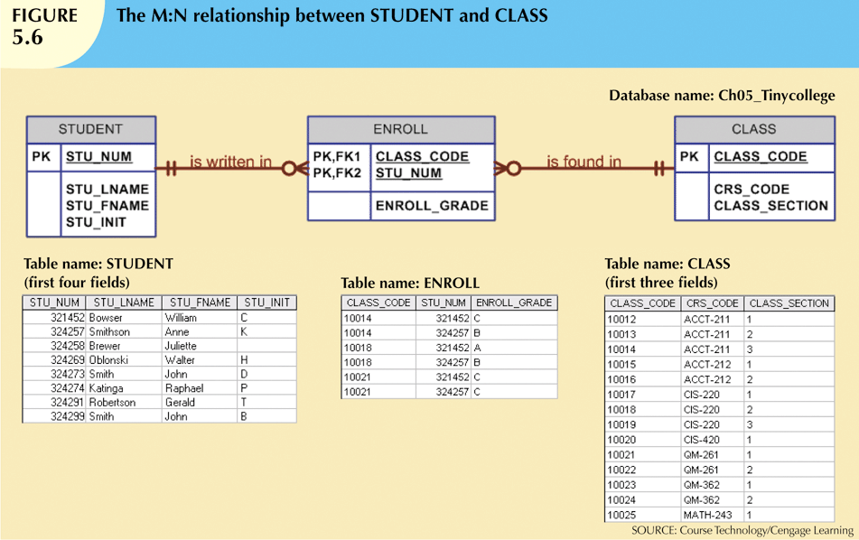
Database Systems, 10th Edition

Slide 29
When to Use Composite Primary Keys
(cont’d.)
When used as identifiers of weak entities normally used to represent:
  Real-world object that is existent-dependent on another real-world object
  Real-world object that is represented in data model as two separate entities in strong identifying relationship
Dependent entity exists only when it is related to parent entity
Database Systems, 10th Edition

Slide 30
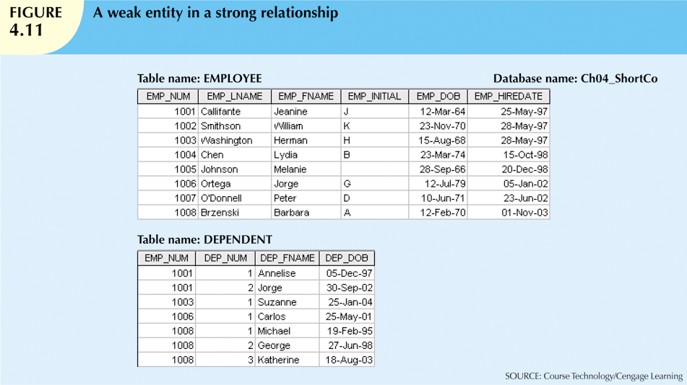
Database Systems, 10th Edition

Slide 31
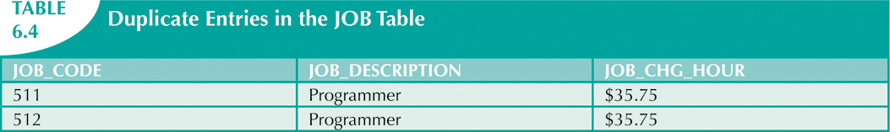
Surrogate Key Considerations
When primary key is considered to be unsuitable, designers use surrogate keys
Data entries in Table 6.4 are inappropriate because they duplicate existing records
  No violation of entity or referential integrity
Database Systems, 10th Edition

Slide 32
When To Use Surrogate Primary Keys
Especially helpful when there is:
  No natural key
  Selected candidate key has embedded semantic contents
  Selected candidate key is too long or cumbersome
Database Systems, 10th Edition

Slide 33
When To Use Surrogate Primary Keys (cont’d.)
If you use surrogate key:
  Ensure that candidate key of entity in question performs properly
  Use “unique index” and “not null” constraints
Database Systems, 10th Edition

Slide 34
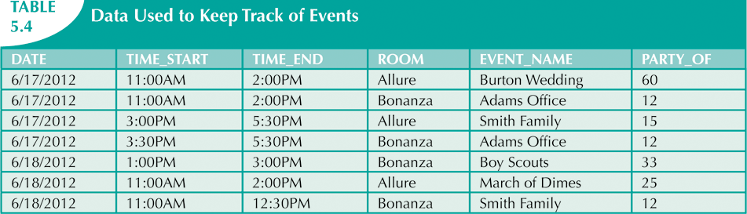
Database Systems, 10th Edition

Slide 35
Design Cases:
Learning Flexible Database Design
Data modeling and design requires skills acquired through experience
Experience acquired through practice
Four special design cases that highlight:
  Importance of flexible design
  Proper identification of primary keys
  Placement of foreign keys
Database Systems, 10th Edition

Slide 36
Design Case 1: Implementing 1:1 Relationships
Foreign keys work with primary keys to properly implement relationships in relational model
Put primary key of the “one” side on the “many” side as foreign key
  Primary key: parent entity
  Foreign key: dependent entity
Database Systems, 10th Edition

Slide 37
Design Case 1: Implementing 1:1 Relationships (cont’d.)
In 1:1 relationship, there are two options:
  Place a foreign key in both entities (not recommended)
  Place a foreign key in one of the entities
    Primary key of one of the two entities appears as foreign key of other
Database Systems, 10th Edition

Slide 38
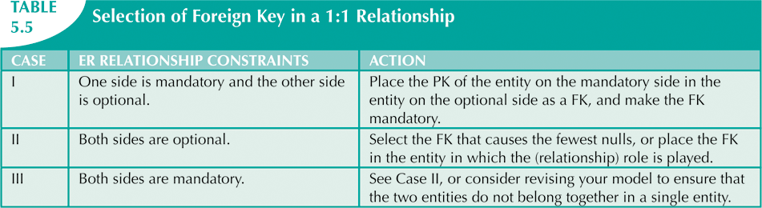
Database Systems, 10th Edition

Slide 39
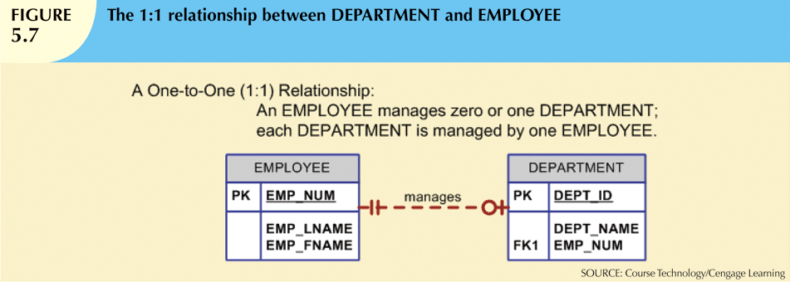
Database Systems, 10th Edition

Slide 40
Design Case 2: Maintaining History of Time-Variant Data
Normally, existing attribute values are replaced with new value without regard to previous value
Time-variant data:
  Values change over time
  Must keep a history of data changes
Keeping history of time-variant data equivalent to having a multivalued attribute in your entity
Must create new entity in 1:M relationships with original entity
New entity contains new value, date of change
Database Systems, 10th Edition

Slide 41
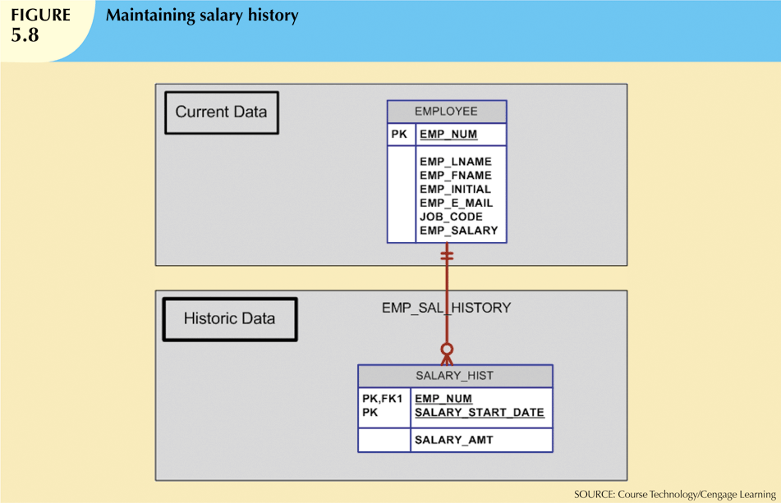
Database Systems, 10th Edition

Slide 42
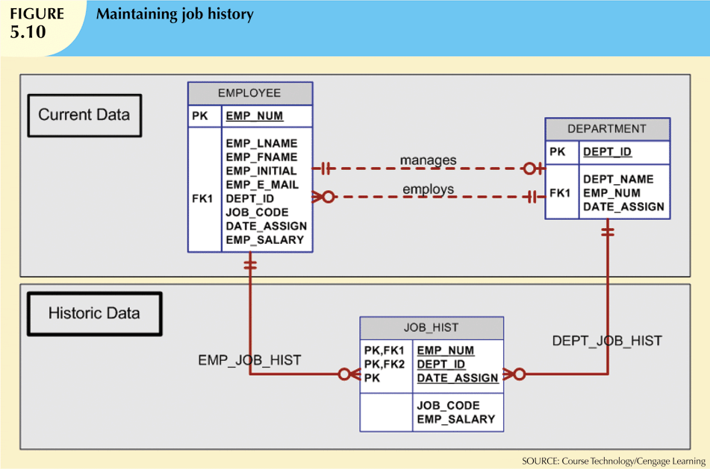
Database Systems, 10th Edition

Slide 43
Design Case 3: Fan Traps
Design trap occurs when relationship is improperly or incompletely identified
  Represented in a way not consistent with the real world
Most common design trap is known as fan trap
Fan trap occurs when one entity is in two 1:M relationships to other entities
  Produces an association among other entities not expressed in the model
Database Systems, 10th Edition

Slide 44
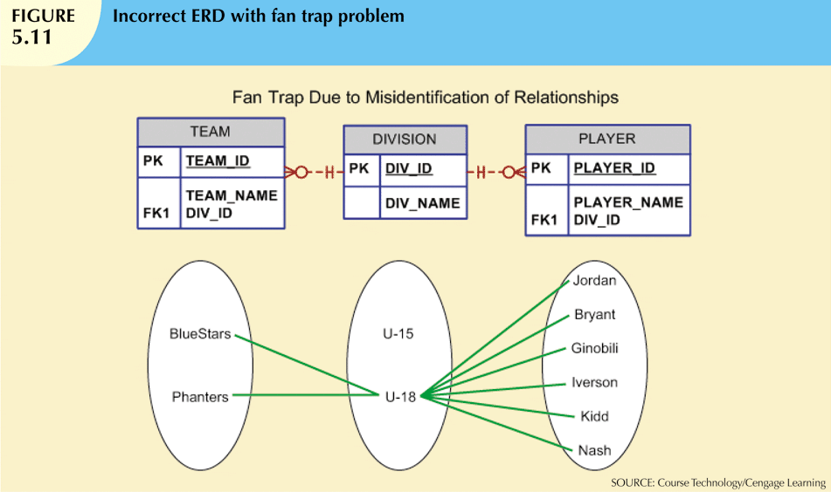
Database Systems, 10th Edition

Slide 45
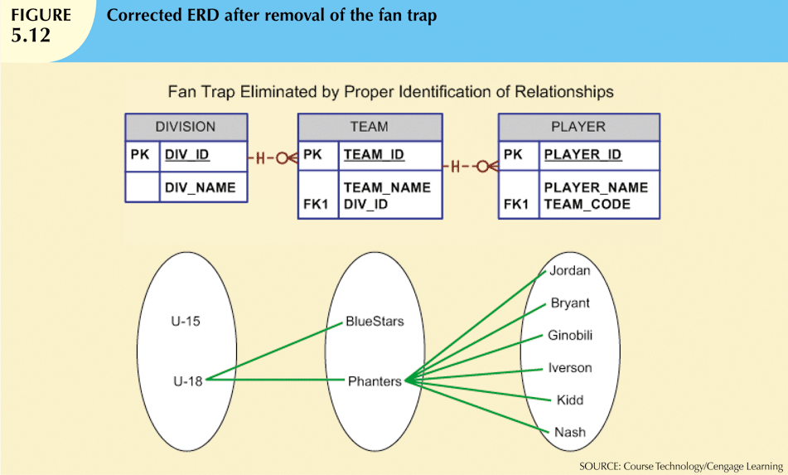
Database Systems, 10th Edition

Slide 46
Design Case 4:
Redundant Relationships
Redundancy is seldom a good thing in database environment
Occurs when there are multiple relationship paths between related entities
Main concern is that redundant relationships remain consistent across model
Some designs use redundant relationships to simplify the design
Database Systems, 10th Edition

Slide 47
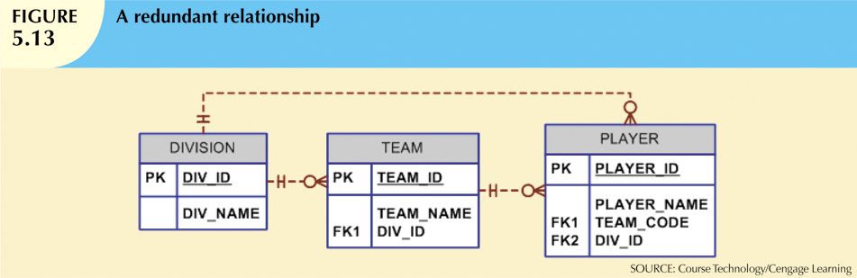
Database Systems, 10th Edition

Slide 48
Summary
Extended entity relationship (EER) model adds semantics to ER model
  Adds semantics via entity supertypes, subtypes, and clusters
  Entity supertype is a generic entity type related to one or more entity subtypes
Specialization hierarchy
  Depicts arrangement and relationships between entity supertypes and entity subtypes
Inheritance means an entity subtype inherits attributes and relationships of supertype
Database Systems, 10th Edition

Slide 49
Summary (cont’d.)
Subtype discriminator determines which entity subtype the supertype occurrence is related to:
  Partial or total completeness
  Specialization vs. generalization
Entity cluster is “virtual” entity type
  Represents multiple entities and relationships in ERD
  Formed by combining multiple interrelated entities and relationships into a single object
Database Systems, 10th Edition

Slide 50
Summary (cont’d.)
Natural keys are identifiers that exist in real world
  Sometimes make good primary keys
Characteristics of primary keys:
  Must have unique values
  Should be nonintelligent
  Must not change over time
  Preferably numeric or composed of single attribute
Database Systems, 10th Edition

Slide 51
Summary (cont’d.)
Composite keys are useful to represent
  M:N relationships
  Weak (strong-identifying) entities
Surrogate primary keys are useful when no suitable natural key makes primary key
In a 1:1 relationship, place the PK of mandatory entity:
  As FK in optional entity
  As FK in entity that causes least number of nulls
  As FK where the role is played
Database Systems, 10th Edition

Slide 52
Summary (cont’d.)
Time-variant data
  Data whose values change over time
  Requires keeping a history of changes
To maintain history of time-variant data:
  Create entity containing the new value, date of change, other time-relevant data
  Entity maintains 1:M relationship with entity for which history maintained
Database Systems, 10th Edition

Slide 53
Summary (cont’d.)
Fan trap:
  One entity in two 1:M relationships to other entities
  Association among the other entities not expressed in model
Redundant relationships occur when multiple relationship paths between related entities
  Main concern is that they remain consistent across the model
Data modeling checklist provides way to check that the ERD meets minimum requirements
Database Systems, 10th Edition

